Slide 1
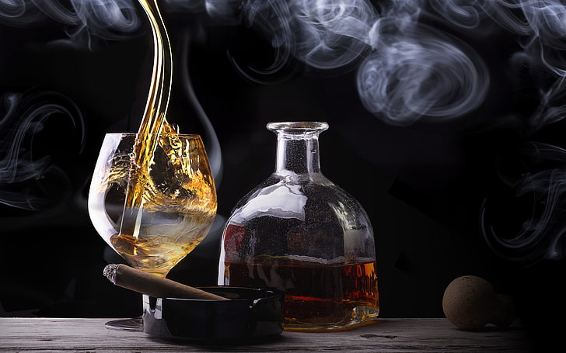
Smoking Drinking can you tell?
“When I read about the evils of drinking, I gave up reading.” Henny Youngman
“Giving up smoking is the easiest thing in the world. I know because I’ve done it thousands of times” Mark Twain
Notes:
Henny Youngman: British-American comedian
Mark Twain: American writer

Slide 2
991,345 total patients from Korea
39% are neither drinkers or smokers
22% only drink
16% drink and smoke
This Dataset by SOO.Y “Smoking and Drinking Dataset with body signal“. https://www.kaggle.com/datasets/sooyoungher/smoking-drinking-dataset?resource=download
Notes:
Smoking and Drinking Dataset with body signal database from Kaggle

Slide 3
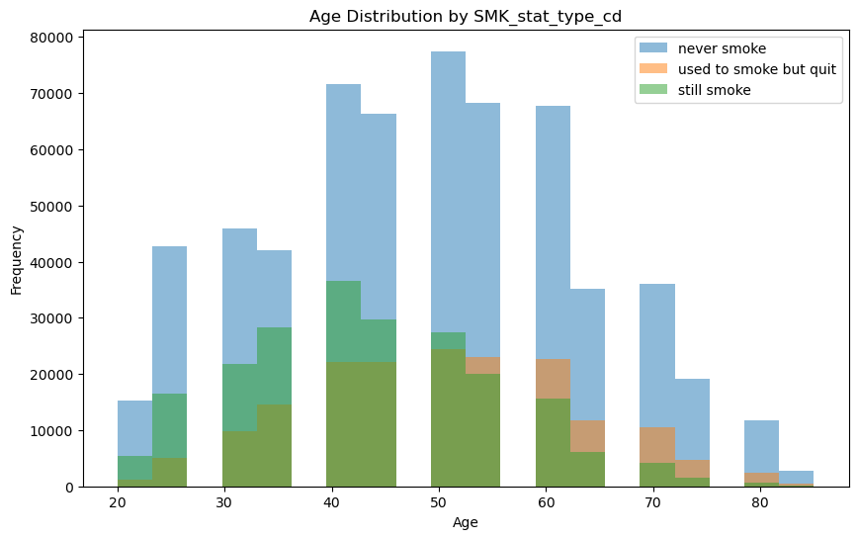
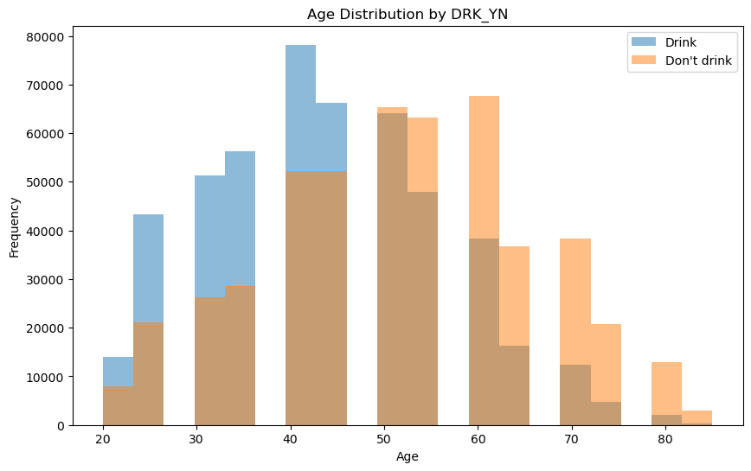
Age distributions
This Photo by Zohir Benmalek
This Photo by Zohir Benmalek

Slide 4
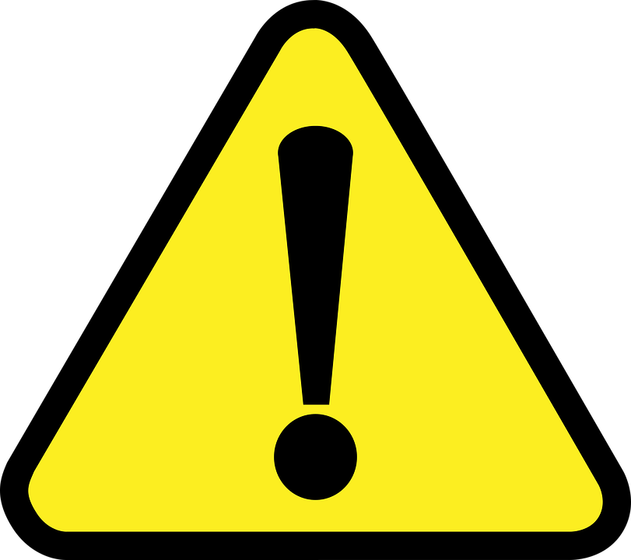
Patient body signals
Eyesight
Hearing
Blood pressure
Cholesterol (LDL and HDL)
Triglyceride
Hemoglobin
Urine protein
Serum creatinine
Aspartate transaminase and Alanine transaminase
Gamma GTP

Slide 5
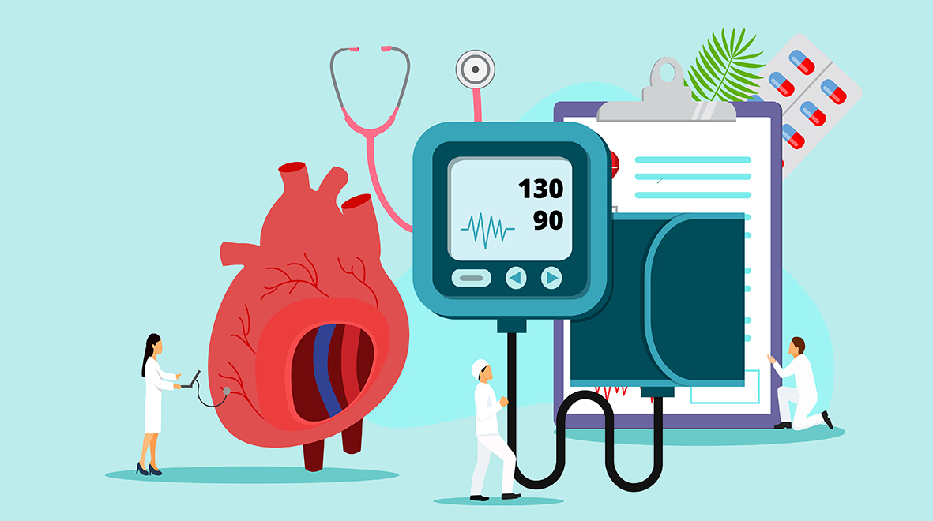
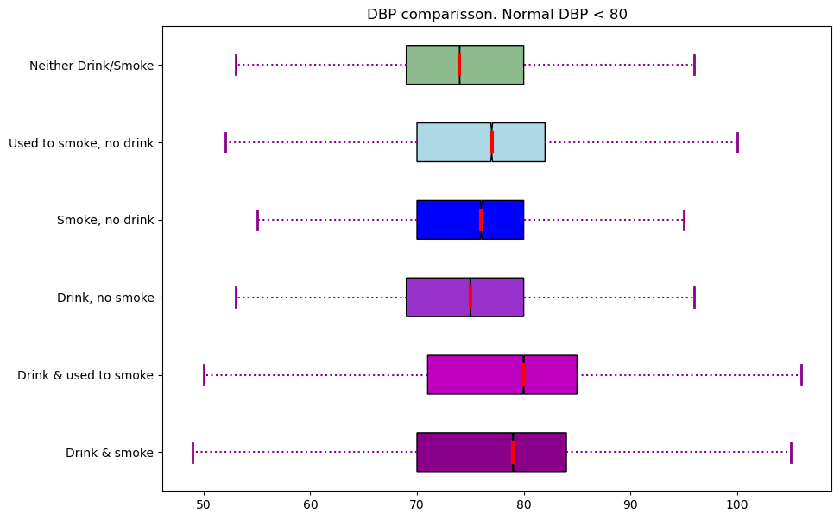
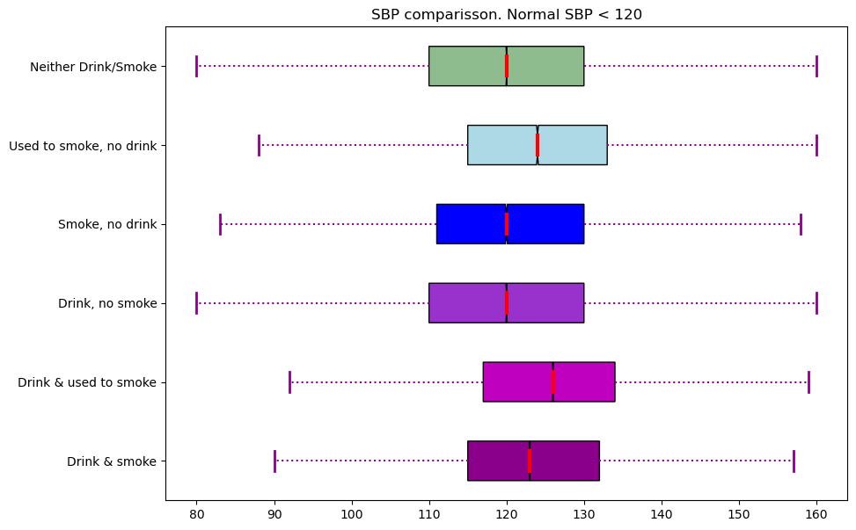
Blood pressure
Notes:
Diastolic blood pressure.
Systolic blood pressure.
* Former smokers and those who smoke and drink currently show a higher SBP than normal and also higher range for both SBP and DBP.

Slide 6
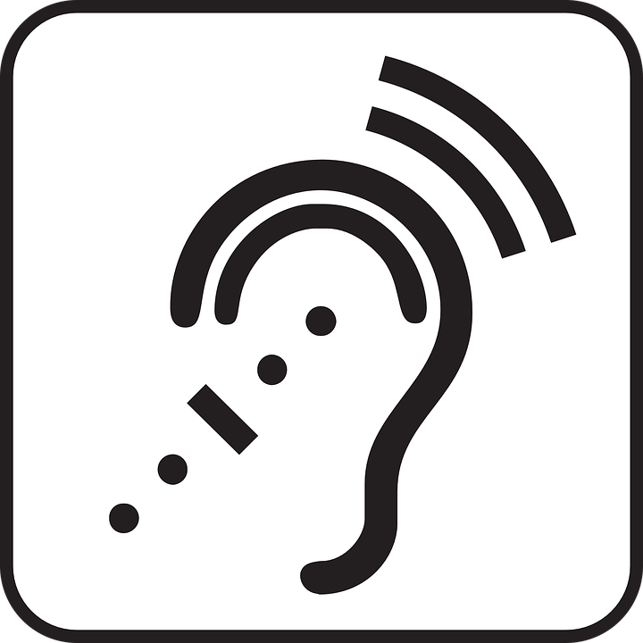
Abnormal Hearing
 | Drink & smoke | Drink & used to smoke | Drink | Smoke | Used to smoke | Not drink or smoke
Right side | 1.8% | 2.9% | 1.8% | 3.1% | 5.6% | 4.2%
Left side | 1.9% | 3.1% | 1.9% | 3.2% | 5.9% | 4.3%
* Values are percentages of the sampled group that were diagnosed with abnormal hearing.
Notes:
Smokers and former smokers indicate more abnormal hearing; however, nonsmokers/nondrinkers also present the second highest number of records for abnormal hearing. This could indicate there is another aspect that might be affecting overall hearing of population not related to drinking or smoking.

Slide 7
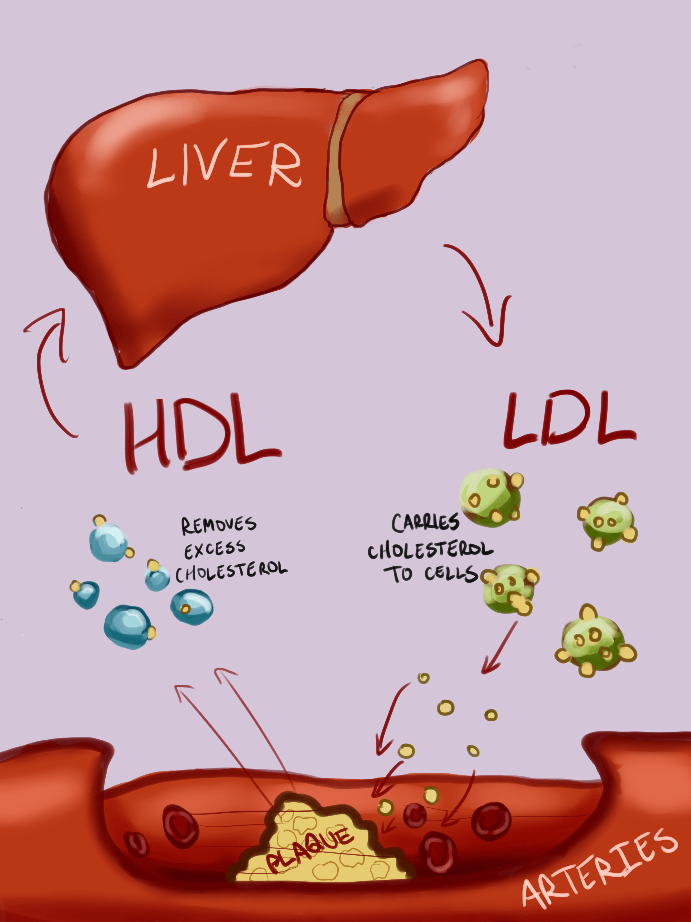
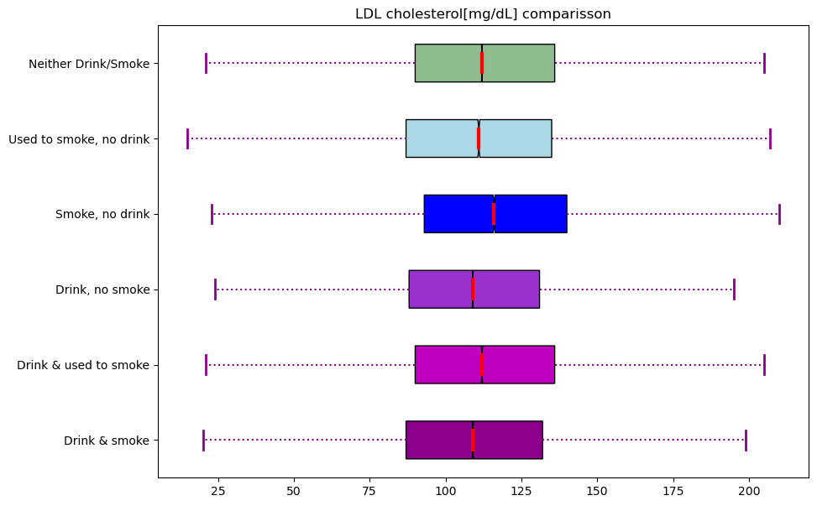
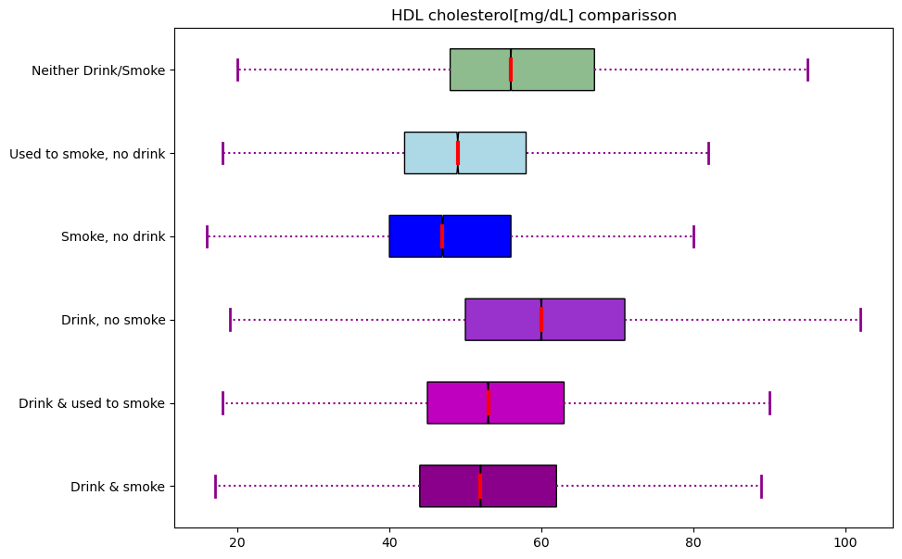
Cholesterol levels
Notes:
LDL (Bad) Cholesterol:
Less than 100 mg/dL Optimal
100-129 mg/dL Near optimal/above optimal
130-159 mg/dL Borderline high
160-189 mg/dL High
HDL (Good) cholesterol:
Less than 40mg/dL Very Low
40-60 mg/dL Low
60 + Optimal

Slide 8
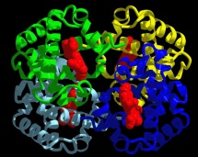
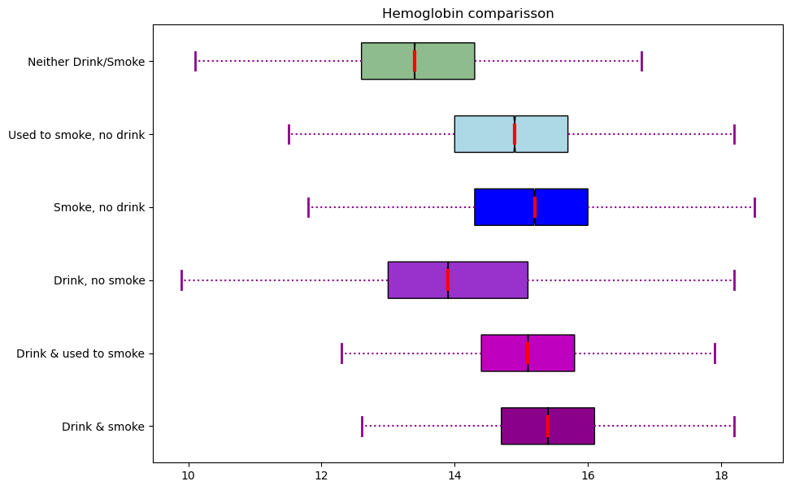
Hemoglobin
Notes:
Normal hemoglobin
Male: 13.5-17.5 g/dL
Female 11.5-15.5 g/dL
Former as well as current smokers tend to have higher hemoglobin levels, although all 75th percentiles remain below the male 17.5 normal hemoglobin levels, the max values lie on 18 or higher which increases risk of complications such as blood clots.

Slide 9
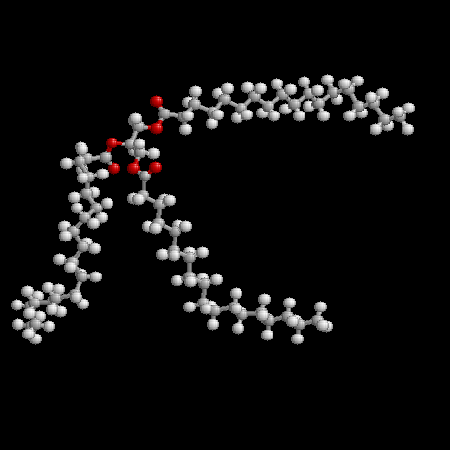
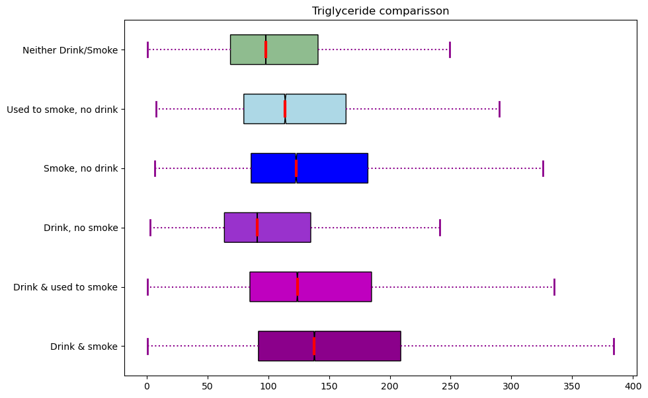
Triglyceride
Notes:
Healthy: Below 150 milligrams per deciliter mg/dL
Borderline high: Between 150 and 199 mg/dL
High: Between 200 and 499 mg/dL.
High triglycerides may contribute to hardening of the arteries or thickening of the artery walls (arteriosclerosis) — which increases the risk of stroke, heart attack and heart disease. Extremely high triglycerides can also cause acute inflammation of the pancreas (pancreatitis).

Slide 10
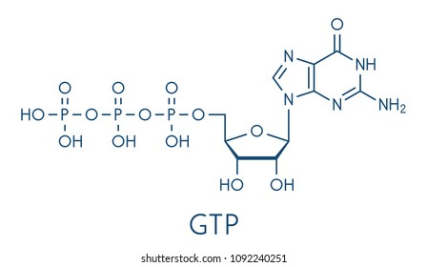
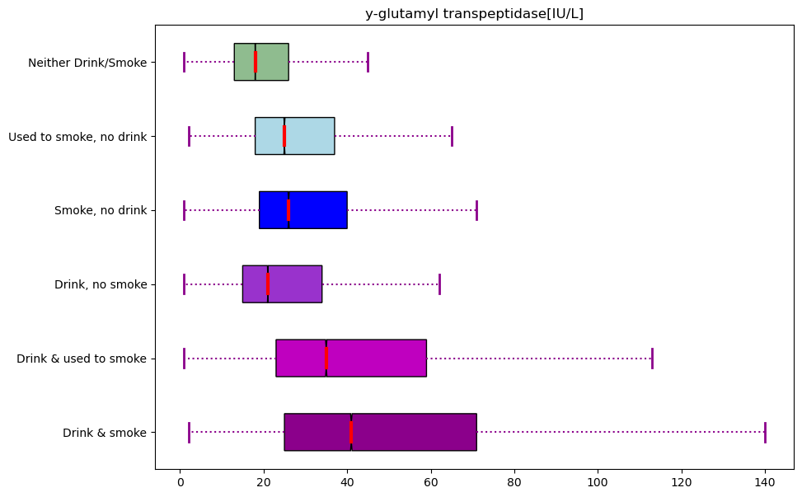
Gamma_ggt
Notes:
7 to 47 U/L for males
5 to 25 U/L for females
Higher than normal test results could be a sign of liver damage from diseases, such as hepatitis, cirrhosis, tumors, or pancreatic cancer.
Higher GGT levels also may mean liver damage from heavy, chronic alcohol abuse.

Slide 11
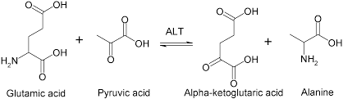
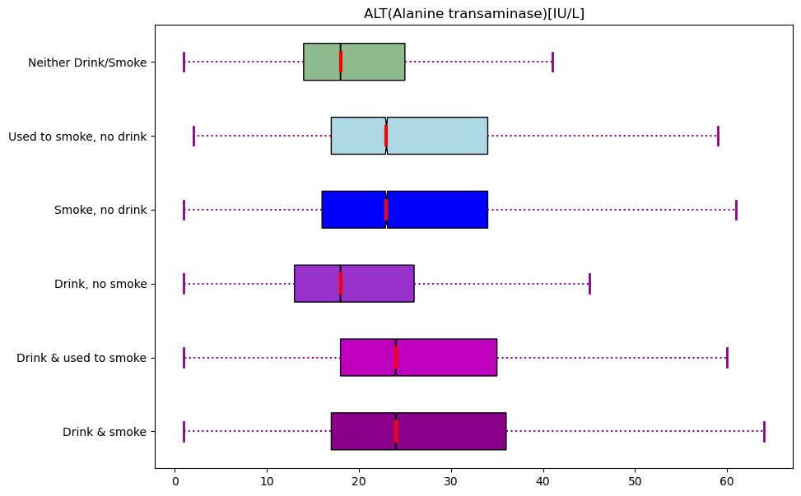
ALT (Alanine transaminase)
Notes:
One common reference range for an ALT blood test is 7 to 56 U/L (units per liter)
High levels of ALT in your blood can be due to damage or injury to the cells in your liver.

Slide 12
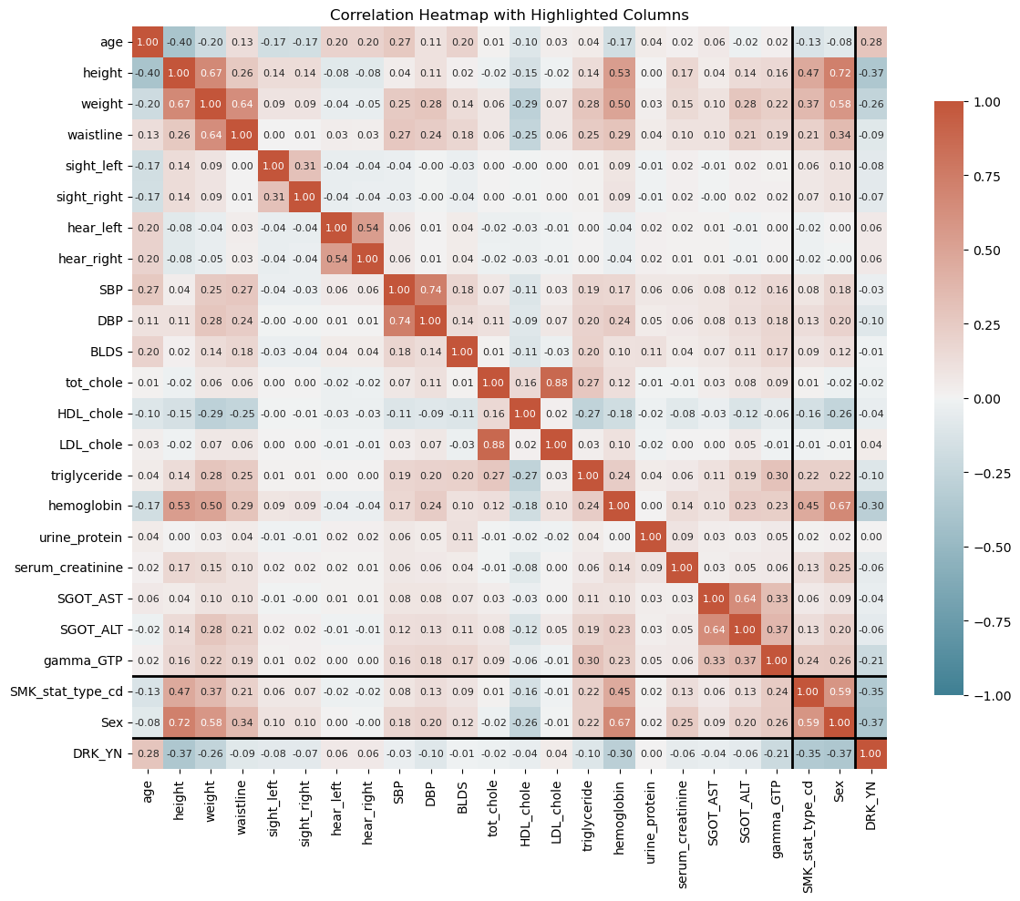
Correlated body signs
DRINKING | SMOKING
DBP Triglyceride Hemoglobin Gamma_GTP Smoking state | DBP Triglyceride Hemoglobin Gamma_GTP Drinking state Serum Creatinine ALT HDL Cholesterol
Title: Smoker and drinkers analysis and classification
Author: Zohir Benmalek
Date: 08/30/2023
Availability: https://www.kaggle.com/code/zohirmalek/smoker-and-drinkers-analysis-and-classification

Slide 13

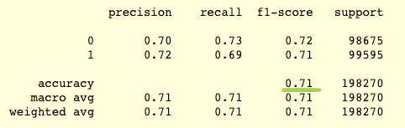
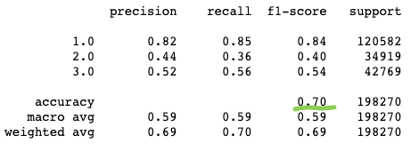
So, Can a machine tell?
Drinker
Smoker
Notes:
Precision: true positives/Total predicted positive.
Recall: true positives/ total actual positive
F1-score: function of precision and recall
Accuracy: Correct predictions

